Slide 1



Crop and Fertilizer Recommendation System using Machine Learning
Name : Harsh Raj
AICTE internship Reg id : STU67eaa51eeb30c1743430942
AICTE internship id : INTERNSHIP_174099535967c57b1f336c3

Slide 2

Learning Objectives
Python
Learnt About Different Modules.
Learnt about dictionaries.
Learnt about Libraries.
Machine Learning.
Decision Tree Classifier.
Recommendation System.
Crop
Fertilizer
GOAL
Source :
www.freepik.com/

Slide 3
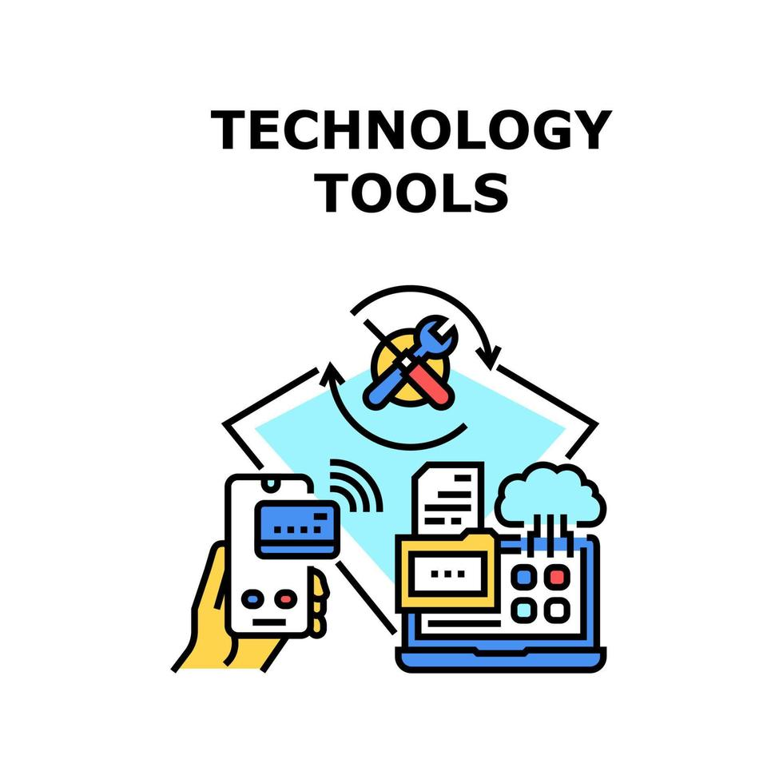
Tools and Technology used
Programming Language : Python.
Environment Variable : Google Collab, Jupyter(Anaconda).
Libraries Used : a. Scikit Learn : Machine Leaning(ML).
b. Matplotlib : Plotting.
c. Seaborn : Visualization.
d. Pandas : Dataframe (or Anlysis).
Picture Source : Google.com

Slide 4
Methodology
1. Data Collection.
2. Data Preprocessing.
3. Model Building.
4. Training The Model.
5. Evaluation of Model.
Data collection involves gathering raw information for subsequent analysis and research.
Selecting and creating a machine learning model based on the problem type.
Assessing model performance using metrics like accuracy, precision, and recall on test data.
Cleaning, transforming, and organizing raw data to make it suitable for analysis.
Feeding preprocessed data into the model to help it learn patterns and relationships.

Slide 5
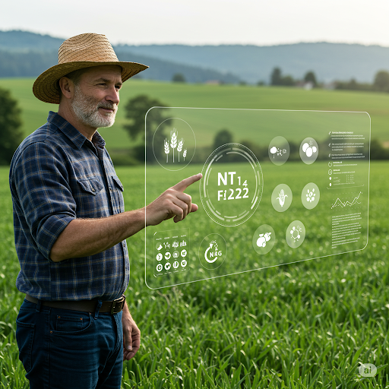
Problem Statement:
Farmers often struggle to choose the best crop and fertilizer combination due to lack of soil knowledge and agricultural expertise. This project aims to build
Crop Recommendation System
Fertilizer Recommendation System
Using Machine Learning that suggests optimal crops and fertilizers based on soil type, nutrients, and environmental conditions.
The system will enhance agricultural productivity, reduce resource wastage, and support sustainable farming practices. It will empower farmers with data-driven insights to make informed cultivation decisions.
Picture Source : Gemini.ai

Slide 6
Solution:
Green Skilly, powered by AI and Machine Learning, helps farmers make smart decisions about crops and fertilizers.
It analyzes soil data like nitrogen, phosphorus, potassium, pH, and moisture to suggest the best crop.
The crop prediction model achieved a high accuracy of 98.48%, ensuring reliable recommendations.
For fertilizers, it gives 100% accurate suggestions based on nutrient deficiencies in the soil.
Farmers get clear, simple advice on what to sow and what input to use—no guesswork needed.
This system helps increase crop yield while reducing unnecessary use of fertilizers and resources.
Ultimately, it empowers farmers to grow more with less, leading to better profits and sustainable farming.
Github Repository : https://github.com/harshraj4830/EDUNET-INTERNSHIP-WEEK-3

Slide 7
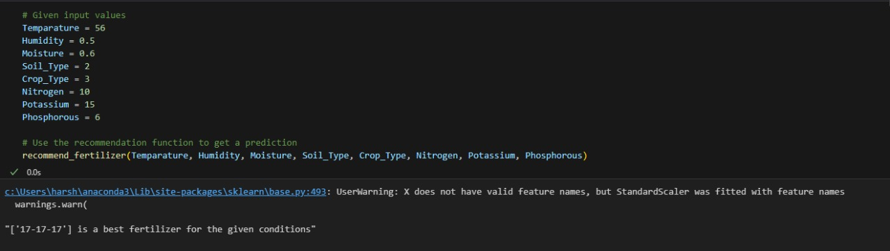
Screenshot of Output:
I. Fertilizer Recommendation System
1.
Fertilizer Recommended based on given Condition of Soil

Slide 8
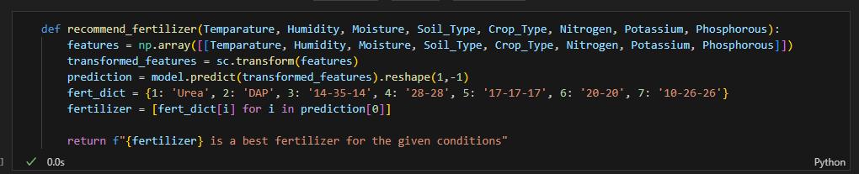
Screenshot of Output:
I. Fertilizer Recemmendation System
2.
Predicts the best fertilizer type based on environmental
and soil nutrient conditions using the trained model.

Slide 9
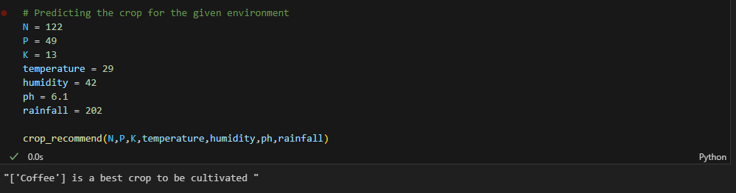
Screenshot of Output:
II. Crop Recommendation system.
1.
Prediction Of a crop Based on Given Environment.

Slide 10
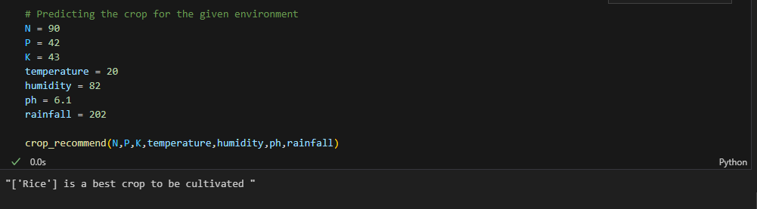
Screenshot of Output:
II. Crop Recommendation system.
2.
Prediction Of a crop Based on Other Given Environment.

Slide 11
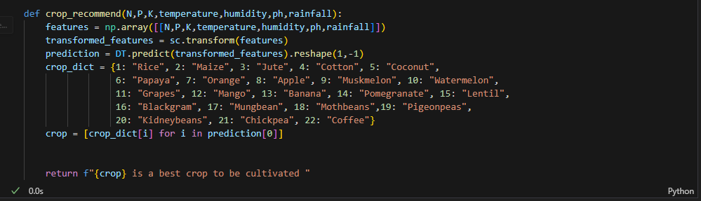
Screenshot of Output:
II. Crop Recommendation system.
3.
Predicts the best Crop type based on environmental
and soil nutrient conditions using the trained model.

Slide 12
Conclusion:
Green Skilly bridges the gap between traditional farming and smart agriculture using AI-driven insights.
With high accuracy in crop and fertilizer recommendations, farmers can now make confident, data-backed decisions.
The system promotes sustainable farming by minimizing input waste and maximizing crop yield.
Farmers benefit from improved productivity, reduced costs, and better income through optimized practices.
Green Skilly empowers even small-scale farmers to embrace modern technology for efficient and profitable farming.
Future Scope
The system currently uses Decision Tree Classifier (DTC) for accuracy, with potential improvements using Random Forest Classifier (RFC) for better generalization. With large-scale data, future advancements include Deep Learning (DL) and Natural Language Processing (NLP) for smarter, more personalized recommendations.

